Slide 1
A Presentation On Case Study: Online Food Ordering System

Slide 2
Objective
Scalability and Flexibility
Usability
Customer Journey
Operational Efficiency
Data Aggregation
Adaptability

Slide 3
Analyzing Online Food Ordering System with different Queries:

Slide 4
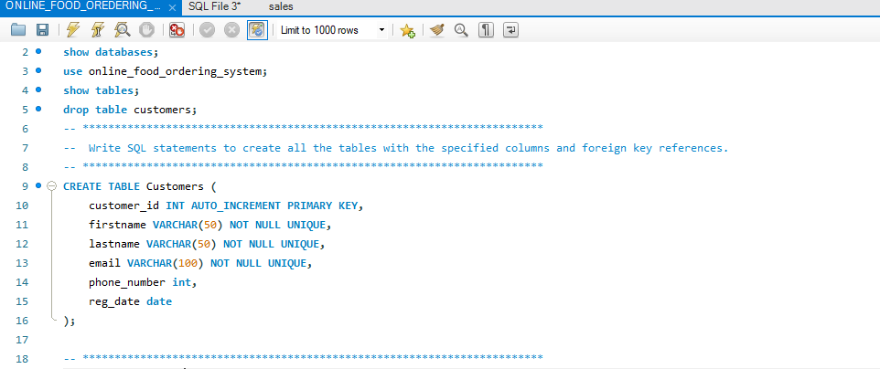
Creating Table

Slide 5
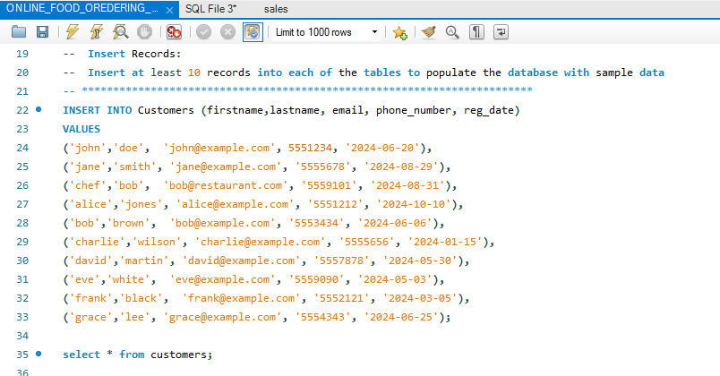
Inserting into Tables

Slide 6
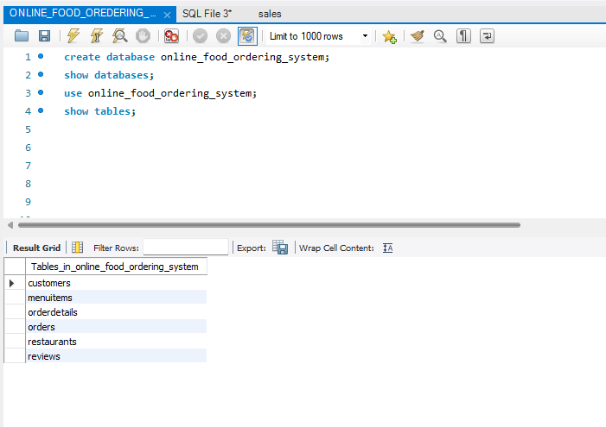
Tables into databases

Slide 7
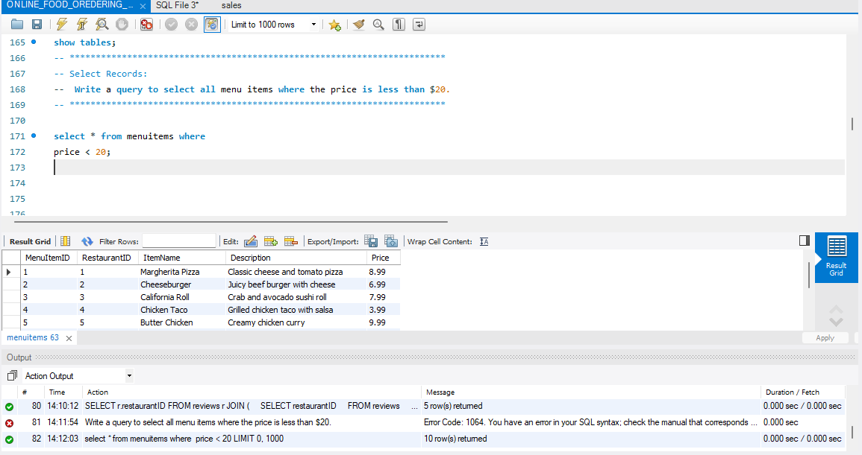

Slide 8
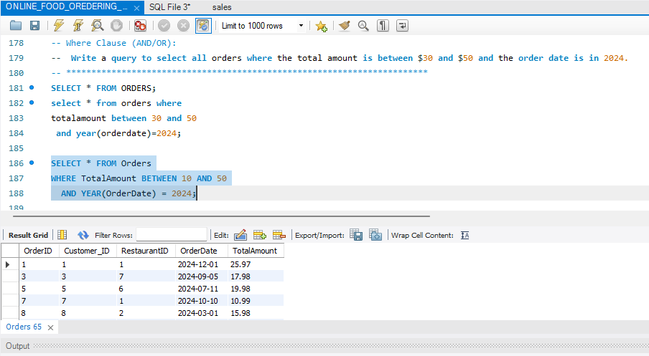

Slide 9
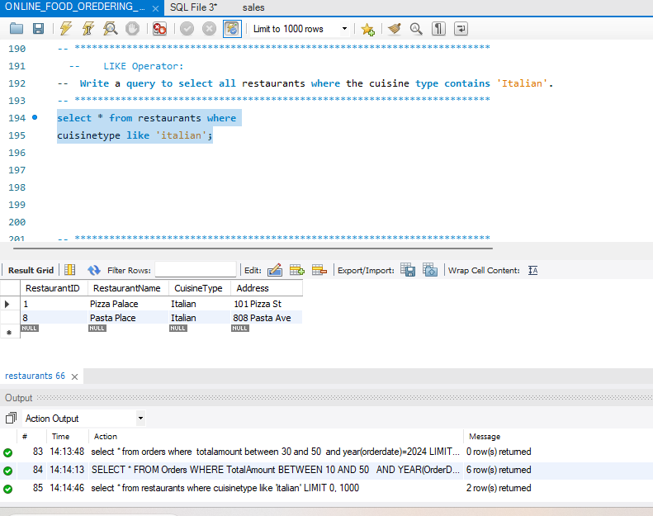

Slide 10
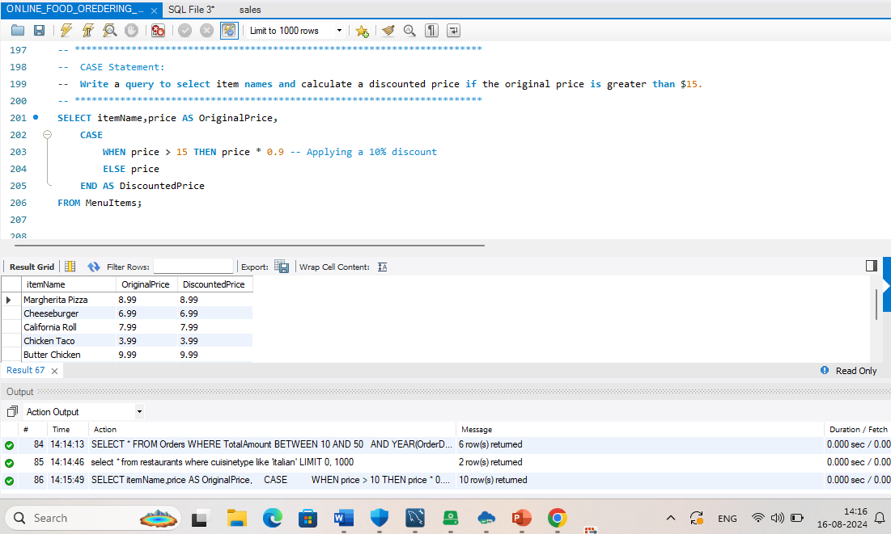

Slide 11
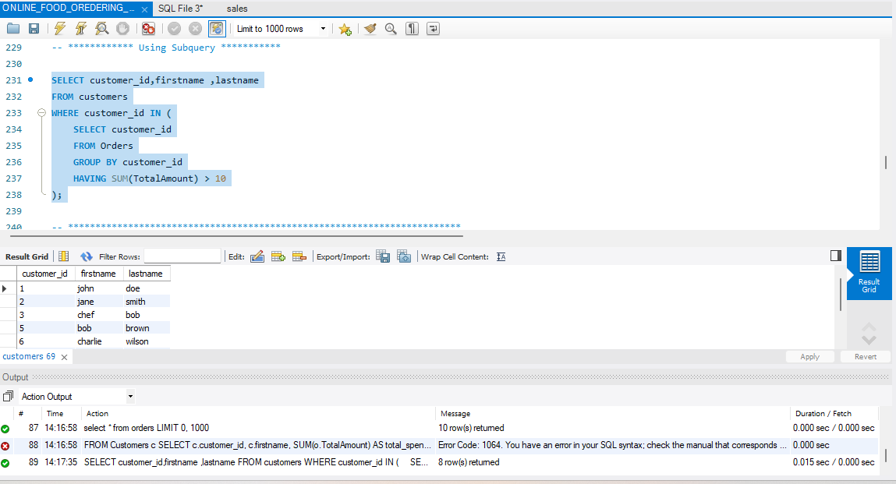

Slide 12
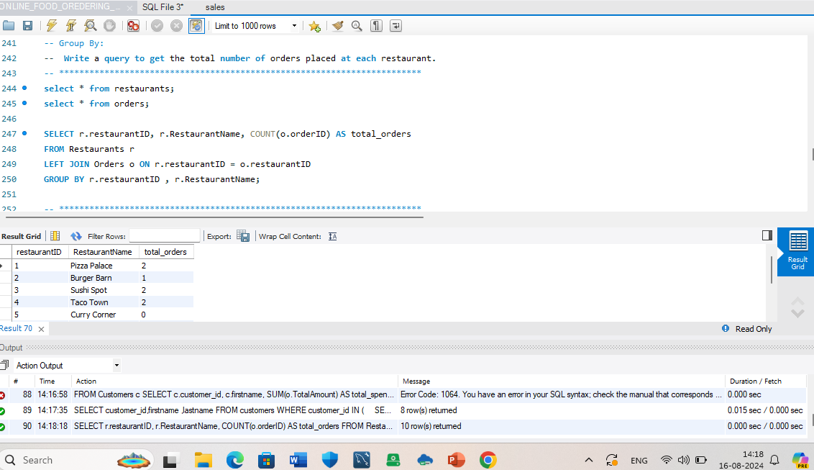

Slide 13
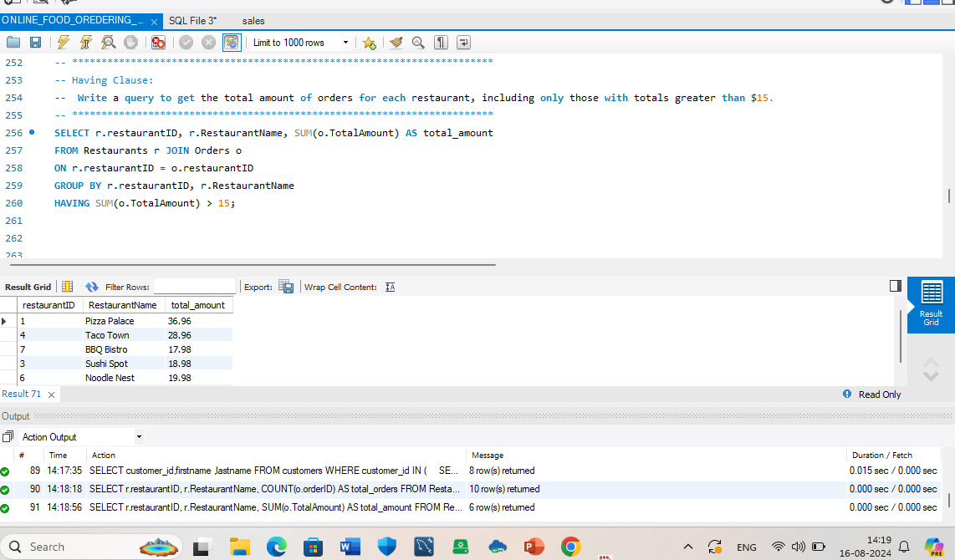

Slide 14
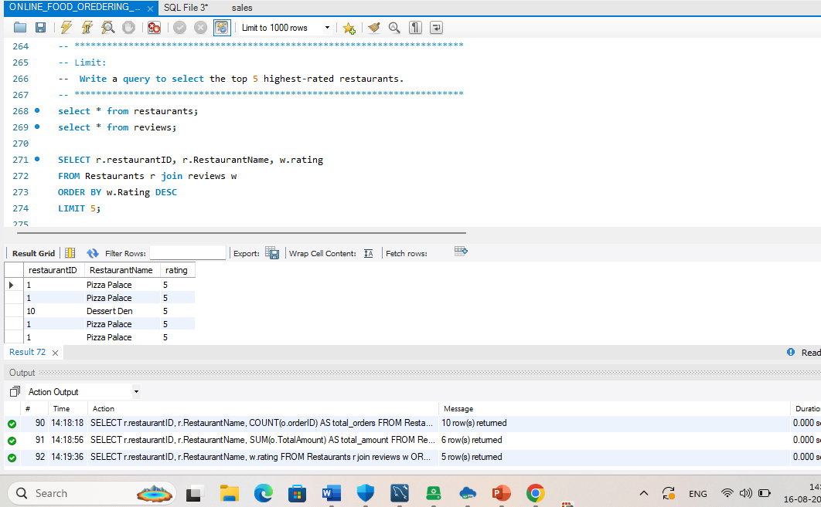

Slide 15
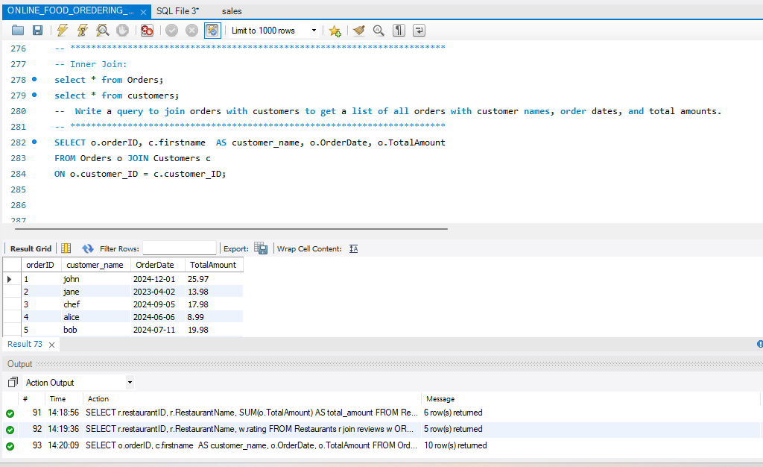

Slide 16
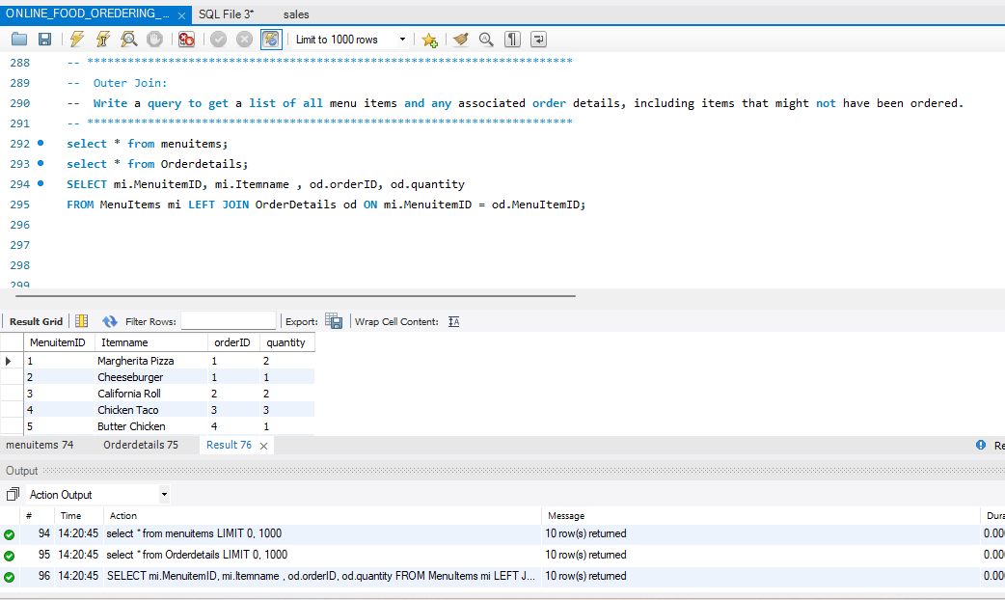

Slide 17
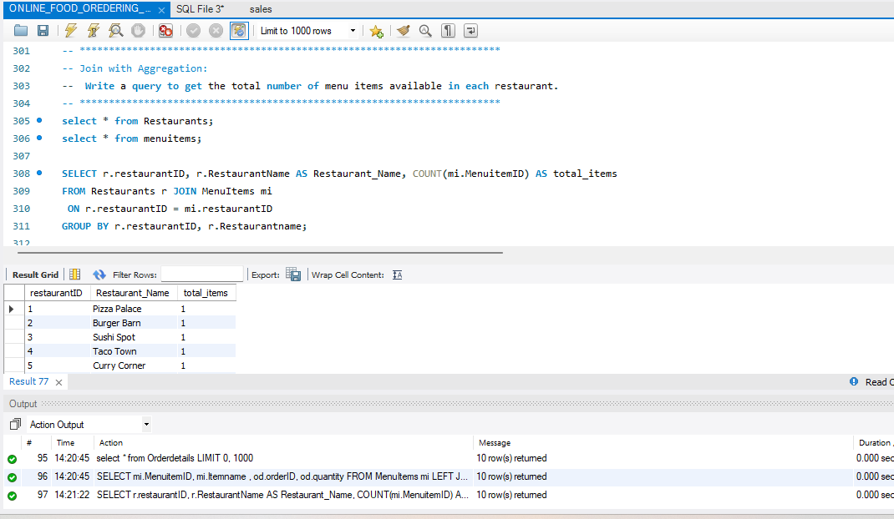

Slide 18
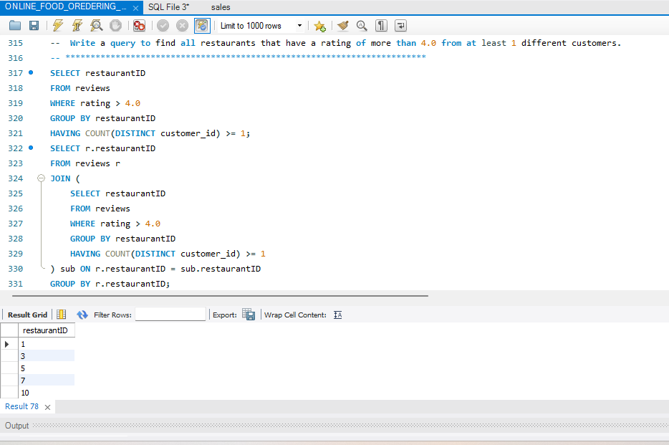

Slide 19
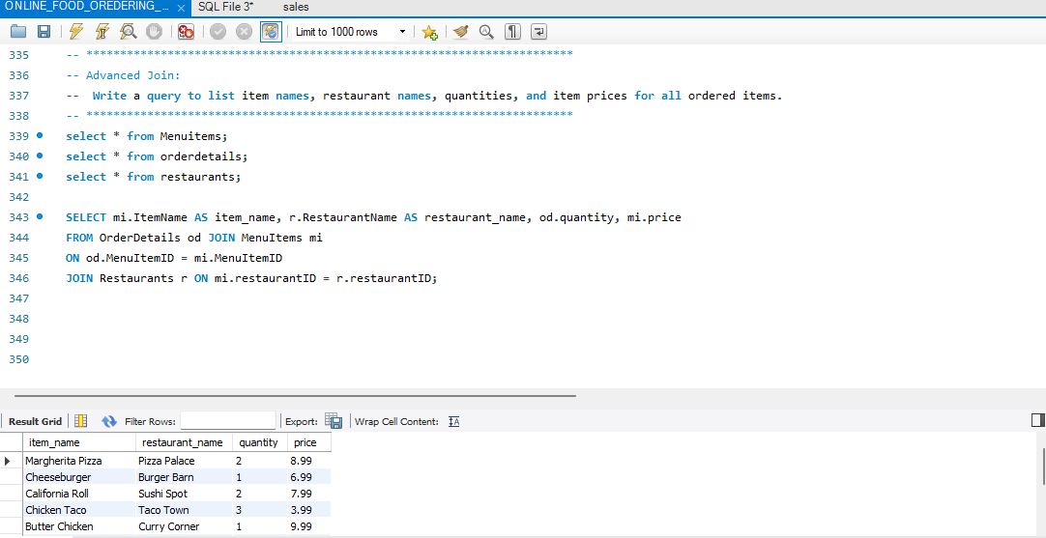

Slide 20
Conclusion
By focusing on these objectives and utilizing relevant SQL queries, the case study can provide a comprehensive analysis of the online food ordering system’s database schema, highlighting strengths and areas for improvement.

